Slide 1
MCCP6020
Advanced English for Academic Purposes
Session 8
Writing the Abstract and Acknowledgements Sections
Coherence, Cohesion and Signposting

Slide 2
Learning Outcomes
By the end of this session, students should be able to:
write the abstract and acknowledgements sections using appropriate organizational structure and linguistic features
set a good title for a manuscript
use appropriate rhetorical devices to enhance cohesion and coherence in academic writing

Slide 3
Warm-up Task
Form a group of 2-3 students and discuss the following questions.
1. Why is the abstract necessary for academic research articles?
The abstract concisely reports the aims and outcomes of your research so
that readers know exactly what the paper is about.
2. What kind of information do you think should be included in an abstract?
Research problem and objectives
Methods
Key results or arguments

Slide 4
3. Is there a structure for research article abstracts?
Move 1 – Introduction (Background, research objectives, hypotheses)
Move 2 – Methods
Move 3 – Results
Move 4 – Discussion/Conclusion/Implications
4. When is an abstract usually written? At the beginning of the research stage or near the final stage of the paper /after completion? Why?
An abstract highlights the key findings and perhaps the implications of the findings as well, so it is consequently written at the final stage of the paper.

Slide 5
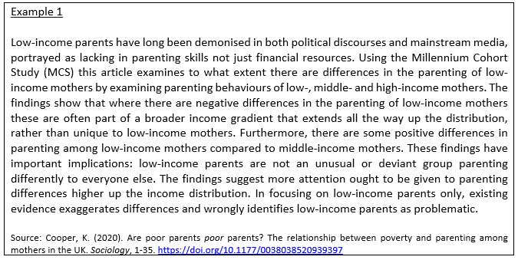
Task 1
Read the following example abstracts in the fields of Sociology and Biology. Analyse the move structure and the linguistic features.

Slide 6
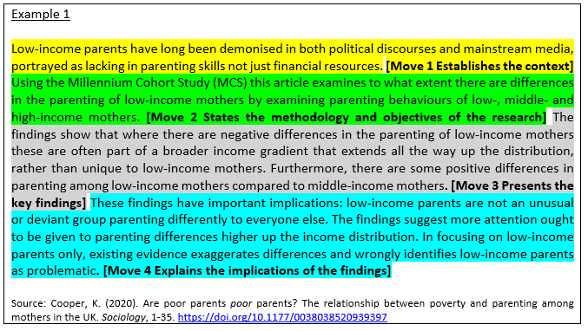
What do you notice about the move structure of the abstracts above?
Suggested answers:

Slide 7
Example 2 Background Patients with pelvic malignancies often receive radiosensitising chemotherapy with radiotherapy to improve survival; however, this is at the expense of increased normal tissue toxicity, particularly in elderly patients. Here, we explore if an alternative, low-cost, and non-toxic approach can achieve radiosensitisation in mice transplanted with human bladder cancer cells. Other investigators have shown slower growth of transplanted tumours in mice fed high-fibre diets. We hypothesised that mice fed a high-fibre diet would have improved tumour control following ionising radiation (IR) and that this would be mediated through the gut microbiota. Results We investigated the effects of four different diets (low-fibre, soluble high-fibre, insoluble high-fibre, and mixed soluble/insoluble high-fibre diets) on tumour growth in immunodeficient mice implanted with human bladder cancer flank xenografts and treated with ionising radiation, simultaneously investigating the composition of their gut microbiomes by 16S rRNA sequencing. A significantly higher relative abundance of Bacteroides acidifaciens was seen in the gut (faecal) microbiome of the soluble high-fibre group, and the soluble high-fibre diet resulted in delayed tumour growth after irradiation compared to the other groups. Within the soluble high-fibre group, responders to irradiation had significantly higher abundance of B. acidifaciens than non-responders. When all mice fed with different diets were pooled, an association was found between the survival time of mice and relative abundance of B. acidifaciens. The gut microbiome in responders was predicted to be enriched for carbohydrate metabolism pathways, and in vitro experiments on the transplanted human bladder cancer cell line suggested a role for microbial-generated short-chain fatty acids and/or other metabolites in the enhanced radiosensitivity of the tumour cells. Conclusions Soluble high-fibre diets sensitised tumour xenografts to irradiation, and this phenotype was associated with modification of the microbiome and positively correlated with B. acidifaciens abundance. Our findings might be exploitable for improving radiotherapy response in human patients. Source: Then, C.K., Paillas, S., Wang, X.D., Hampson, A., & Kiltie, A.E. (2020). Association of Bacteroides acidifaciens relative abundance with high-fibre diet-associated radiosensitisation. BMC Biology, 18, 102. https://doi.org/10.1186/s12915-020-00836-x

Slide 8
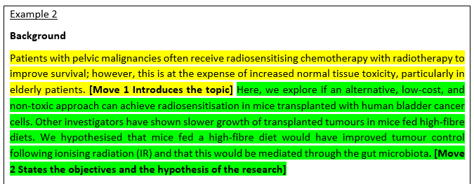

Slide 9
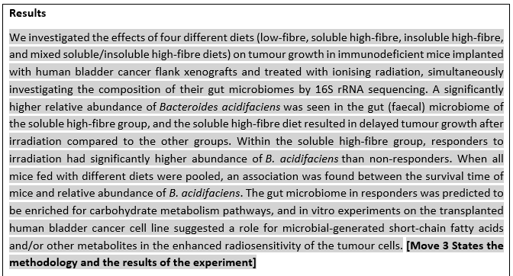

Slide 10
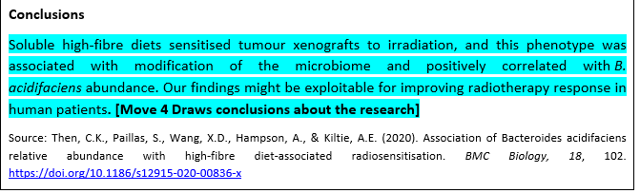

Slide 11
Moves | Example 1 - Sociology | Example 2 - Biology
1 | Establishes the context | Introduces the topic
2 | States the methodology and objectives of the research | States the objectives and the hypothesis of the research
3 | Presents the key findings | States the methodology and the results of the experiment
4 | Explains the implications of the findings | Draws conclusions about the research
The second example is a structured abstract with sub-headings. This is common in the science-related disciplines e.g. medicine.

Slide 12
2.What language features (e.g. tense, voice, cohesive devices, hedging devices) are found in the example abstracts?
Suggested answers:
Example 1 –
The present tense and present perfect tense are used. The active voice is predominantly used.
‘Furthermore’ is used to connect the research results.
A hedging device (suggest) is used to soften the tone when discussing the implications of the findings.
Both the active and passive voices are used to diversify the language.

Slide 13
Example 2 –
The present tense and present perfect tense are used in the background information section.
The past tense is used to refer to the methods adopted and to present the experimental results.
The use of the personal pronoun “we” to refer to the research team is common in the science-related disciplines.
A hedging device (might) is used to soften the tone when discussing the significance of the findings
Both the active and passive voices are used to diversify the language.
In general, when writing a description of the thesis/research article itself, the simple present tense tends to be used. When writing a summary of research that is reported in the thesis/research article, it is likely that both the present and past tenses are used. The present tense is used for the purpose and the conclusions or recommendations, whereas the past tense is used to describe the methods and findings.

Slide 14
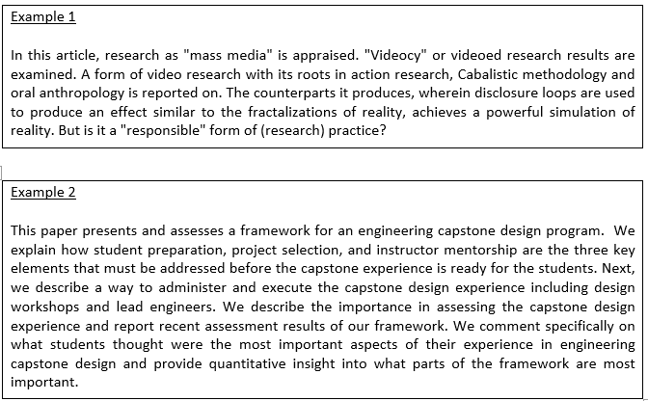
Task 2
Have a look at the following two abstracts. Do you think they are well-written? Why?

Slide 15
Suggested answers:
Both abstracts are not well-written.
Comments on example 1:
The purpose of the research is given but there is nothing about the methodology and it does not explain the scope of the study. It's too short and it leaves readers with a question. No summary or results or conclusions are given. The language is abstruse.
Comments on example 2:
This abstract begins well with a concise statement of the objectives of the paper, but then wanders from good technical writing style from there. The abstract is written in the first person (e.g. “We explain…”, “We discuss…”, “We comment…”, etc.). No results are presented. This poorly written abstract describes only the organization of the paper. Instead, the abstract should summarize the actual results and how they were obtained.

Slide 16
Hyland (2000)¹ examines the abstract structures across disciplines and identified five common moves:
Philosophy | I-P-Pr P-Pr
Sociology | P-M-Pr I-P-Pr I-P-M-Pr
Applied Linguistics | I-P-Pr P-M-Pr P-Pr I-P-M-Pr
Electronic Eng. | P-M-Pr P-Pr
Mechanical Eng. | P-M-Pr P-Pr I-P-Pr
Physics | P-M-Pr P-Pr
Biology | P-M-Pr I-P-M-Pr/I-P-Pr/P-Pr
I = Introduction
P = Purpose
M = Method
Pr = Product (findings)
C = Conclusion (optional)
¹Hyland, K. (2000). Disciplinary discourses: Social interactions in academic writing. London: Longman.

Slide 17
Task 3
Analyse the move structure and the linguistic features of an RA abstract in your own field. Make notes in the table below.
Download one or two research articles that you think are well-written in your own field. You can also use the research articles that you have collected.
Follow the steps that you have been through with the example abstracts above, highlight different parts of the abstract and identify the moves in each part.
Identify the typical words/phrases and grammatical patterns that are used in the abstract. Pay attention to the moves/steps these words/phrases and grammatical pattern fulfil.

Slide 18
 | Abstract 1 | Abstract 2
Moves identified
Typical words/phrases and grammatical patterns observed

Slide 19
Writing the Acknowledgements Section
Hyland and Tse (2004)² studied thesis and dissertation Acknowledgements section in detail. Their work has shown not only that there are typical ways in which these texts are organized but also how students use these texts to display their disciplinary memberships and networks at the same time as they thank the people that helped them in their academic undertaking. Hyland points out that these short and seemingly simple texts “bridge the personal and the public, the social and the professional, and the academic and the moral”.
Hyland and Tse highlighted 3 stages in the Acknowledgements section:
Reflecting – some introspective comment is made about the writer’s research experience.
Thanking – credit is given to individuals and institutions.
Announcing – responsibility for any flaws or errors is accepted and the thesis is dedicated to specific people.
²Hyland, K. & Tse, P. (2004). “I would like to thank my supervisor”. Acknowledgements in graduate dissertations. International Journal of Applied Linguistics, 14(2), 259-275.

Slide 20
The moves are illustrated in the table below:
Move | Example
Reflecting move | The most rewarding achievement in my life, as I approach middle age, is the completion of my doctoral dissertation.
Thanking move Presenting participants Thanking for academic assistance, intellectual support, ideas, analyses, feedback, etc. Thanking for resources, data access and clerical, technical and financial support, etc. Thanking for moral support, friendship, encouragement, sympathy, patience, etc. | I would like to take this opportunity to express my immense gratitude to all those persons who have given their invaluable support and assistance. In particular, I am profoundly indebted to my supervisor, Dr. James Fung, who was very generous with his time and knowledge and assisted me in each step to complete the thesis. The research for this thesis was financially supported by a postgraduate studentship from the University of Hong Kong, The Hong Kong and China Gas Company Postgraduate Scholarship, Epson Foundation Scholarship, two University of Hong Kong CRCG grants and an RCG grant. I’d include those who helped including my supervisor, friends, and colleagues. It is also appropriate to thank for spiritual support, so I’d also include my friends in church and family members.
Announcing move Accepting responsibility for flaws or errors Dedicating the thesis to individual(s) | Notwithstanding all of the above support for this project, any errors and/or omissions are solely my own. I love my family. This thesis is dedicated to them.

Slide 21

HKBU Student Theses and Dissertations
https://scholars.hkbu.edu.hk/en/studentTheses/

Slide 22
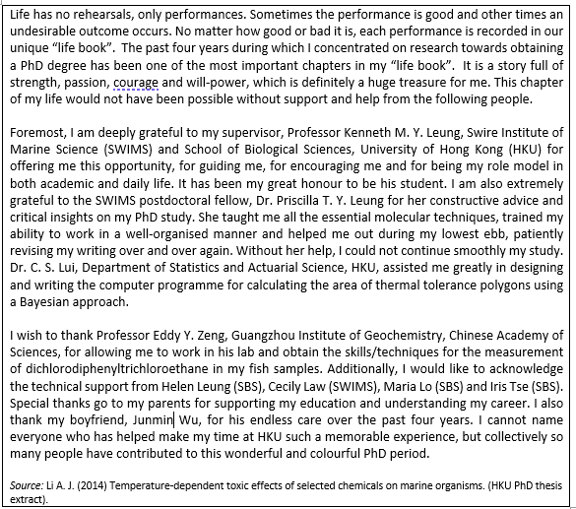
Task 4
Analyse the structure of the following Acknowledgements section and identify the ways the writer has expressed gratitude.
Suggested answer:
This acknowledgements section appears to have each of the three moves: reflecting, thanking and announcing. Credit is given to academic and intellectual support, technical and practical assistance and personal encouragement.
https://esl.gatech.edu/sites/default/files/LI/li-how_to_write_acknowledgements_in_a_dissertation.pdf

Slide 23
Structuring your Thesis: Coherence, Cohesion and Signposting
The organisation of a thesis can be studied from the perspective of macrostructure and microstructure. Does the text have a clear macrostructure that suits the overall communicative intent of the thesis? Are the ideas properly linked to enable the text to have internal unity? These are questions you should ask as a writer and your reader will ask as someone who needs to comprehend your work.
Coherence (macro-level)
Coherence is concerned with the connection and logical flow of ideas in a text to create unity.
Cohesion (micro-level)
Cohesion is concerned with the links between words and sentences.

Slide 24
Signposting
A thesis should have an informative title, headings, and subheadings. It should present information in a logical order; include all essential steps in any argument and make any implications clear; give sufficient evidence; give examples where appropriate; and explain why any point is particularly important.
Signposts signal key aspects of the work, such as purpose, structure, author’s stance, main points, direction of the argument, conclusions.
The first signpost in a thesis is the title and this needs to be as informative as possible. Include all necessary key words to correctly and fully convey the content of the study. Delete all words that are redundant or do not contribute to the essential meaning. Order the words to reflect accurately the meaning you intend to convey.

Slide 25
Part 1: Have a look at the titles of a few papers that you have been reading. What are some features of a good title?
Task 5 Creating an Effective Title for a Research Paper/Thesis
Choose a journal article title that you think is effective. Put the title in the Google Doc.
Discuss in pairs. What makes a title effective?
Advice from Springer: Title, Abstract and Keywords | Springer — International Publisher

Slide 26
Steps for Creating a Research Paper Title
Part 2: Watch a video about the steps for creating a research paper title.
https://blog.wordvice.com/best-title-for-journal-manuscript/
Answer some basic questions about your paper (objective, methods, results)
Identify and list keywords and phrases from these responses
Write a long sentence with these keywords
Create a working title; delete unnecessary and redundant words
Delete extra elements to meet suitable word count; put key terms at beginning and end
* Add a subtitle if necessary

Slide 27
Coherence
Techniques for enhancing the coherence of writing include:
A macrostructure that provides a pattern characteristic and appropriate to its communicative purpose (e.g. using a chronological approach to tell a story, explaining the problem before suggesting the solutions in a problem-solution essay)
An information structure that guides the reader in understanding how information is organized and how the topic of text is developed (e.g. giving old information before new information)
Connectivity of the underlying content evidenced by relations between propositions (e.g. giving supporting evidence and examples to support a proposition)
Connectivity of the surface text evidenced by the presence of cohesive devices (e.g. pronoun references – he, she, it, this, that; conjunctions – but, also, therefore, however) and content lexical ties (e.g. repetition, synonymy/antonymy, and superordinate/hyponymy – animals/cats)
Appropriate metadiscourse features: Some examples are logical connectives (e.g. therefore, but), sequencers (e.g. firstly, secondly, finally), certainty markers (e.g. certainly, no doubt) and hedges (e.g. can, may)

Slide 28
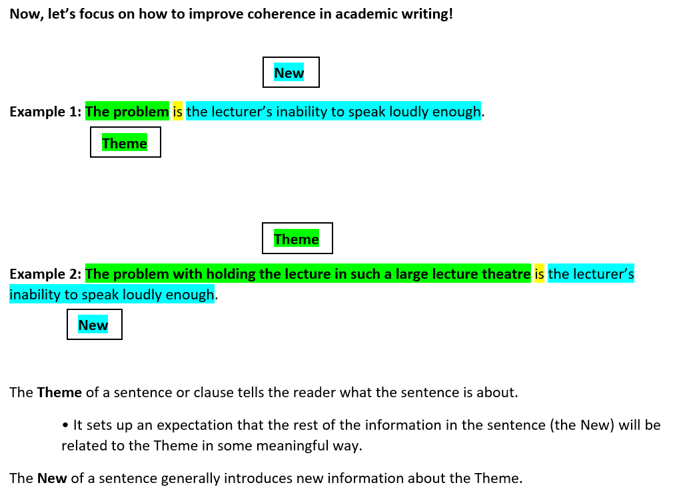
Task 6

Slide 29
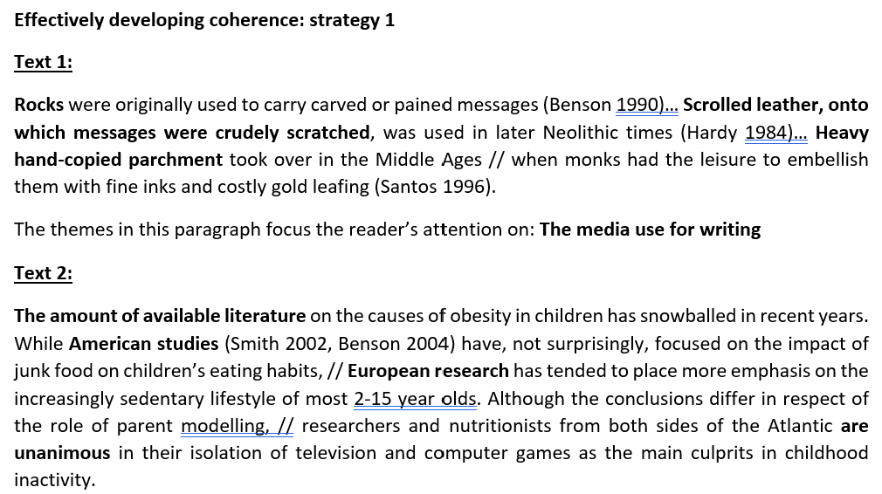
Task 6
What is the theme of this passage?
The literature on the causes of obesity in children

Slide 30
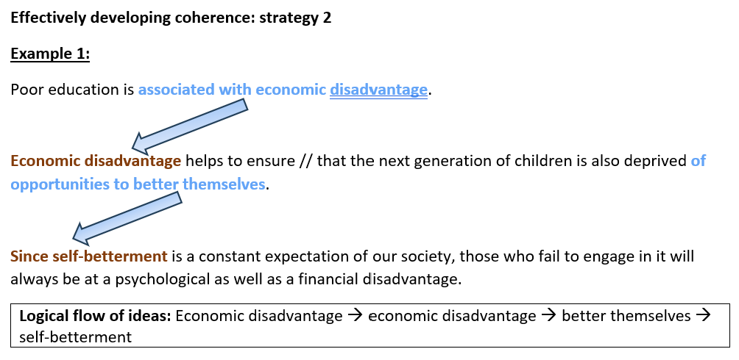
Task 6

Slide 31
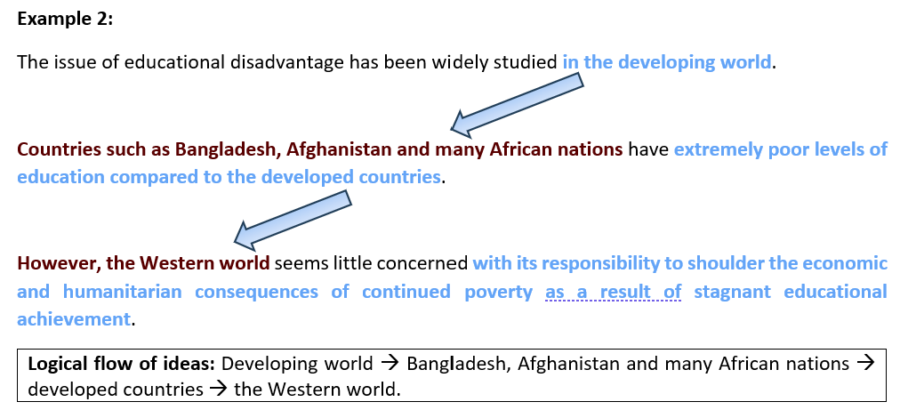
Task 6

Slide 32
Task 6
Which text is more coherent? Why?
Text A
Attracting customers to buy your products and services needs a great deal of research and planning to ensure the money you invest in gaining customers pays off. This is normally achieved through market research and involves finding more about the people you hope to sell to. Armed with this information you can then formulate an effective plan of action based on your evidence. Once you are aware of the needs of your potential customers you need to examine your product in detail, fix a suitable price which will help your product sell, ensure you choose the correct method of distribution and select an appropriate promotion to attract your audience. This is known as the marketing mix and can help your business to spend money wisely with the best results.
Text B
Attracting customers to buy your products and services needs a great deal of research and planning to ensure the money you invest in gaining customers pays off. Firstly, there is market research and involves finding more about the people you hope to sell to. Secondly, formulate an effective plan of action based on your evidence. Furthermore, it is important to examine your product in detail. Moreover, you should fix a suitable price which will help your product sell, ensure you choose the correct method of distribution and select an appropriate promotion to attract your audience. So this is known as the marketing mix and in summary it can help your business to spend money wisely with the best results.

Slide 33
Suggested answers:
The first text is the original text and is highly cohesive – even though it does not contain many obvious linking words. Text B may at first sight look more cohesive, but in fact most of the cohesion words are wrongly used. Be careful of overusing that sort of language.
Incorrect linking:
Is “Firstly” really the first point made in Text B? To use it correctly, you need to identify that there is a list of points to come: “There are a variety of issues here; firstly,..”
The same comment applies to the use of “secondly”
“So” is used when a conclusion can be made – typically in conversation rather than academic writing. This is the final point, but it is not a conclusion.

Slide 34
Cohesion
All languages provide a certain number of lexico-grammatical elements which highlight, on the sentence and paragraph level, the sense relation of one textual unit to those preceding or following it. Such formal or stylistic devices have a guiding function for the reader. They support and speed up the cognitive processes by which a reader constructs the overall meaning of the linearly incoming textual information. This is why an author must take care that there is a tight fit of meaning and form. The cohesive elements which languages offer for the structuring and ease of understanding of texts can best be illustrated by some examples.
Strategies for making a text more cohesive include the use of:
Transitions or connectives
Referencing
Lexical chains
Anaphoric nouns
Substitution and ellipsis

Slide 35
Cohesion – Practice Task
Analyse the use of cohesive devices in a short paragraph in a journal article of your choice.
How did the authors ensure the coherence of the text and the logical flow of ideas?

Slide 36
Transitions
One of the ways of comprehensibly presenting and structuring information is the chronological presentation of facts or events. There are a few options for making clear the order in which ‘things’ happened. A straightforward way of making clear their sequence is the use of lexical items like first … second … third …finally. In certain types of stories or reports a similar effect is achieved by the use of lexical items like in the beginning/at the start/to start with/after that/and then/in between/before that/following on that/in the end …
In other texts the sense relations among the individual parts of a text may be that they compare, contrast, or evaluate facts or events or ideas by using words like similarly/in the same way/in a different way/on the one hand … on the other hand/in contrast/though/however/moreover/in addition/on top of …/whereas…
When authors present arguments or cause and effect relations they typically use words and phrases like because/consequently/ therefore/ as a result/ … Conditional truths may be announced by words like depending on/ given that/ assuming that…

Slide 37
Here is a brief list of some common discourse markers:
Types | Examples
To add | also, and, again, and then, equally important, finally, further, furthermore, too, next, lastly, what is more, moreover, in addition, first (second)
To compare/contrast | whereas, but, yet, on the other hand, however, nevertheless, on the contrary, by comparison, compared to, although, conversely, meanwhile, in contrast, notwithstanding, alternatively, otherwise, instead,
To show effect | because, for, since, that is, due to, thus, therefore, hence, accordingly
To sequence | first(ly), second(ly), finally, previously, formerly, next, then, later, lastly, and so forth, following, afterwards, subsequently, concurrently, simultaneously
To repeat | in other words, in brief, as noted, that is
To emphasize (use sparingly) | definitely, extremely, obviously, indeed, absolutely, never, emphatically, unquestionably, without doubt, certainly, undeniably, without reservation
To provide example | for example, for instance, to demonstrate, to illustrate, as an illustration
To conclude | in brief, on the whole, summing up, to conclude, in conclusion, as a result, consequently, all in all

Slide 38

II. Referencing – pronouns, demonstratives, or other expressions to refer back to something previously mentioned or to point forward to something that will be mentioned later.
Be careful when using pronouns (words such as it, they, them, he, him, she and her). If pronouns are overused, the focus can be hard for the reader [What is ‘it’ or ‘they’?].
There is often confusion over whether the use of pronouns is singular or plural.
Another mistake involves using a pronoun which could refer to more than one subject.

Slide 39
A pronoun must agree with its antecedent (i.e. the noun to which the pronoun refers) and the relationship between the two must be clear and unambiguous. Vague pronoun reference occurs when this relationship is not clear.
A pronoun can only be used to replace a noun if its reference is immediately obvious and not confusing. Check that if you are referring to a person, you use the correct pronoun, i.e. ‘he’ or ‘she’, and generally that your use of pronouns is not misleading.

Slide 40
2. Demonstratives of the definite article ‘the’ + a signaling noun
e.g. this, that, these, those, such, the + NOUN
However, the researchers also conducted a subsequent study. This study strongly confirmed the results of the previous one.
The qualities of a good critic are clear perception, fine sensibility and eloquence. These same qualities are needed by lecturers.
He was faced with a difficult choice. The choice he made demonstrated his ability to make sound decisions under extreme pressure.

Slide 41
3. Comparatives
e.g. another, other, both, similar, the same, better, earlier, previous, later, subsequent
The research has undoubtedly revolutionized thinking in the field. The same could be said of Druy’s (2003) later research.
…it has been shown that in the absence of another meal, the previous one may be kept in the stomach for more than twice as long as usual (Chitty, 1938), presumably with a gradual increase in stomach acidity, …
The algorithm could in principle reduce crime but aggravate… Yet, the opposite appears to be true in our data.
The more precise terms that he uses are ‘isotropic’ and ‘Quinean’. The former means that anything in the domain of belief is potentially relevant to what is being considered; the latter means that the falsification or verification of propositions is done relative to their status in a scientific theory (and, by extension, in a belief system).

Slide 42
III. Lexical Chain
1. Synonyms or antonyms
HIV AIDS is a disease which affects the immune system. Until recently, this condition was little understood.
The way in which money is currently allocated for research encourages poor quality research submissions. This funding mechanism is in urgent need of overhaul.
The mental well-being of these children is equally important. Unhappiness and instability impact significantly on their chances of long-term survival.
2. Categorisation (part to whole; or whole to part)
The majority of percussion instruments entered Western orchestras and the orchestral repertoire in the late 19th century.
Although drums of various kinds had long been a feature of Western orchestral music, mallet percussion instruments were only present from the mid-1800s onwards.

Slide 43
IV. Anaphoric Nouns
Another useful way to show the connection between the ideas in a paragraph is what Gill Francis calls anaphoric nouns (or summary nouns). Look at the following text:
Moulds do not usually grow fast, and conditions had to be found in which large quantities of Penicillium notatum could be produced as quickly as they were wanted. The solution to this problem was helped by N. G. Heatley, a young biochemist also from Hopkins's laboratory in Cambridge, who had been prevented by the outbreak of war from going to work in the Carlsberg laboratories in Copenhagen.
The phrase "this problem" summarises the text in the first sentence and thus provides the connection between the two sentences.

Slide 44
Reports of original work, headed often by the names of many joint authors, became too full of jargon to be understood even by trained scientists who were not working in the particular field. This situation persists today, though strong movements towards interdisciplinary research help to avoid total fragmentation of scientific understanding.
Again, the phrase "This situation" summarises the first sentence.
The phrase: This (or These) + noun(s)
- is very useful in showing the connection between sentences and therefore in making sure that the paragraph flows.

Slide 45
Task 8
Now look at the following sentences and fill in each blank with an appropriate summary noun.
According to a recent survey, 32% of adults in Hong Kong, down from 39% twenty years ago, now smoke. This _______________________ can be partly attributed to the mounting evidence linking smoking with fatal diseases such as cancer.
Nowadays, notebook computers are lighter, more powerful and easier to use than they were five years ago. These ___________________________ have led to an increase in the sales of these machines.
Ozone levels in the world increased 3% from 1990-92, another 4.5% from 1992=94, and an additional 6% from 1994-96. Environmental protection organisations are concerned that if this ___________________ continues, serious environmental damage may occur.
trend/pattern
features/characteristics
trend/pattern

Slide 46
Task 8
Now look at the following sentences and fill in each blank with an appropriate summary noun.
The local manufacturers have decided they will more strongly support the pollution control of the Environmental Protection Department. This _____________ was a major factor in the drafting of new regulations.
Research has revealed that 20 of the 320 known toxic chemicals in the air probably cause more than 2000 cases of cancer annually. While this _____________ may not seem high, it is still a cause for concern.
English teachers know that students need to understand the differences between formal and informal language. However, this _________________ cannot usually be acquired quickly.
decision
number/result
distinction/knowledge

Slide 47
IV. Substitution and Ellipsis
Substitution is the replacement of one item by another and ellipsis is the omission of the item. Substitution is one of the methods of cohesion examined by M.A.K. Halliday and Ruqaiya Hasan in their influential text Cohesion in English (1976).
• Substitution in text can be of a noun/noun phrase or clause. We replace countable nouns or noun phrases with the pronouns one/ones after adjectives or demonstratives, e.g. The first book was critical, the second one was not.
• Verbs or verb phrases can be substituted by ‘do’, e.g. The first interviewee responded emphatically to the question, the second one did not.
• A verb or verb phrase can also be substituted by ‘do so/it/that’, e.g. Many people would like to smoke in public places, but they are banned from doing so.
• If clauses can be replaced by ‘if so’ or ‘if not’, e.g. This paper expects subjects to be more confident in English after an academic writing course; if not, suggestions will be given to improve individually.
• Ellipsis is the omission of a noun/pronoun, verb, infinitive or wh- clause. The noun or pronoun is often left out in the second of two coordinate clauses, e.g. I investigated climate change and (I) examined the impact on land resources.
• Although not the case for modals and auxiliaries, verbs can be omitted to avoid repeating them, e.g. Coffee appeals to some, tea (appeals) to others.

